Slide 1
MS ACCESS 2007

Slide 2
Introduction of Ms Access
Ms Access is one of the most powerful and fixable Database Management System (DBMS). It will enable you to link to data in its existing location and use it for viewing, updating, querying, and reporting. Access consists of four main database objects: Tables, Queries, Forms, and Reports.

Slide 3
Important Terms and Basic Objects
Database File
It is a file which stores the entire database. The database file is saved to your hard drive or other storage devices.
Data types
Data types are the properties of each field. Every field has one data type like text, number, date, etc.
Table
A Table is an object which stores data in Row & Column format to store data.
A Table is usually related to other tables in the database file.
Each column must have Unique name
We can also define Primary Key in a table.

Slide 4
Query
A Query is a way of retrieving and editing information in according to the conditions asked. Many user are afraid of queries because of the technical terms associated with them, such as values, criteria and marks. But there is no to be worry, you can create and use a simple query.
Types of Query can be SELECT, INSERT, UPDATE, DELETE.
Form
A form is a database object that you can use to create a user interface for a database application.
Forms help you to display live data from the table. It mainly used to ease the process of data entry or editing.
Report
A report is an object in desktop databases primarily used for formatting, calculating, printing, and summarizing selected data.
You can even customize the report’s look and feel.

Slide 5
Macros
Macros are used to perform one or more Database action automatically.
Modules
Modules are another types of element in access. It is a program you write using Visual Basic (programming language used to create office software package) used to automate to customize database functions.

Slide 6
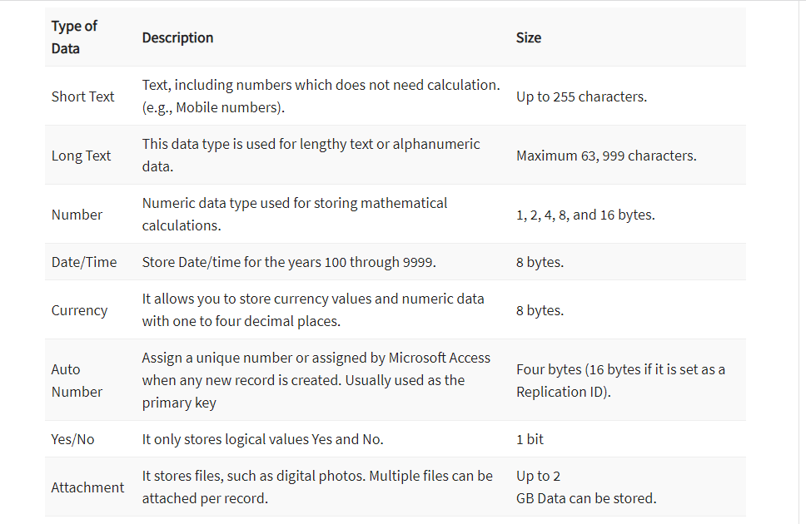
Microsoft Access Data Types

Slide 7
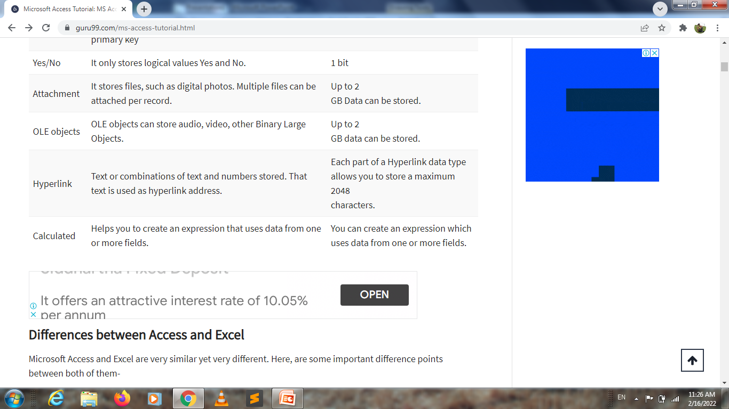

Slide 8
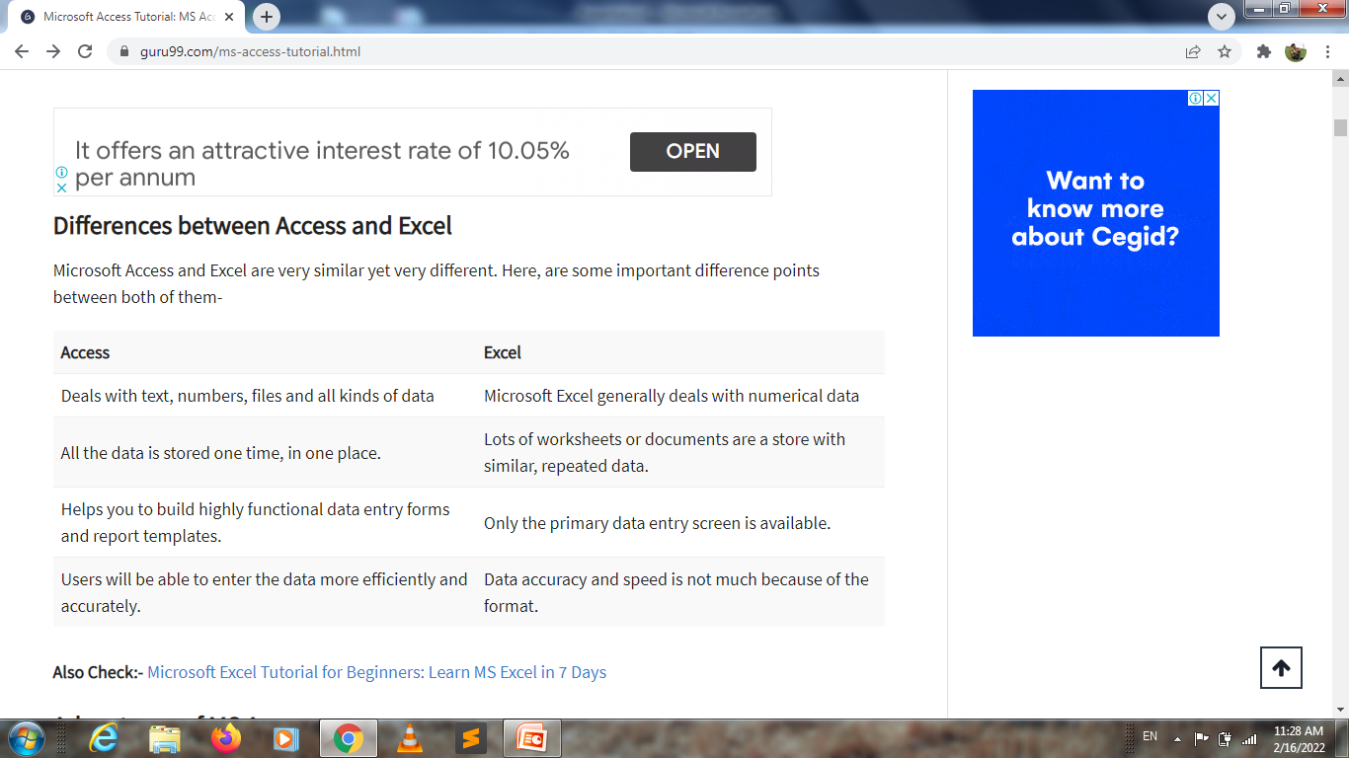

Slide 9
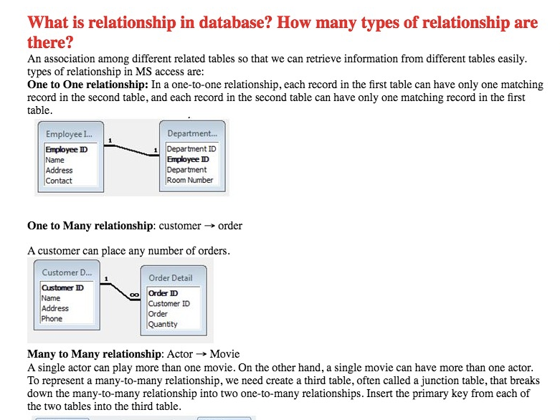

Slide 10
